Slide 1
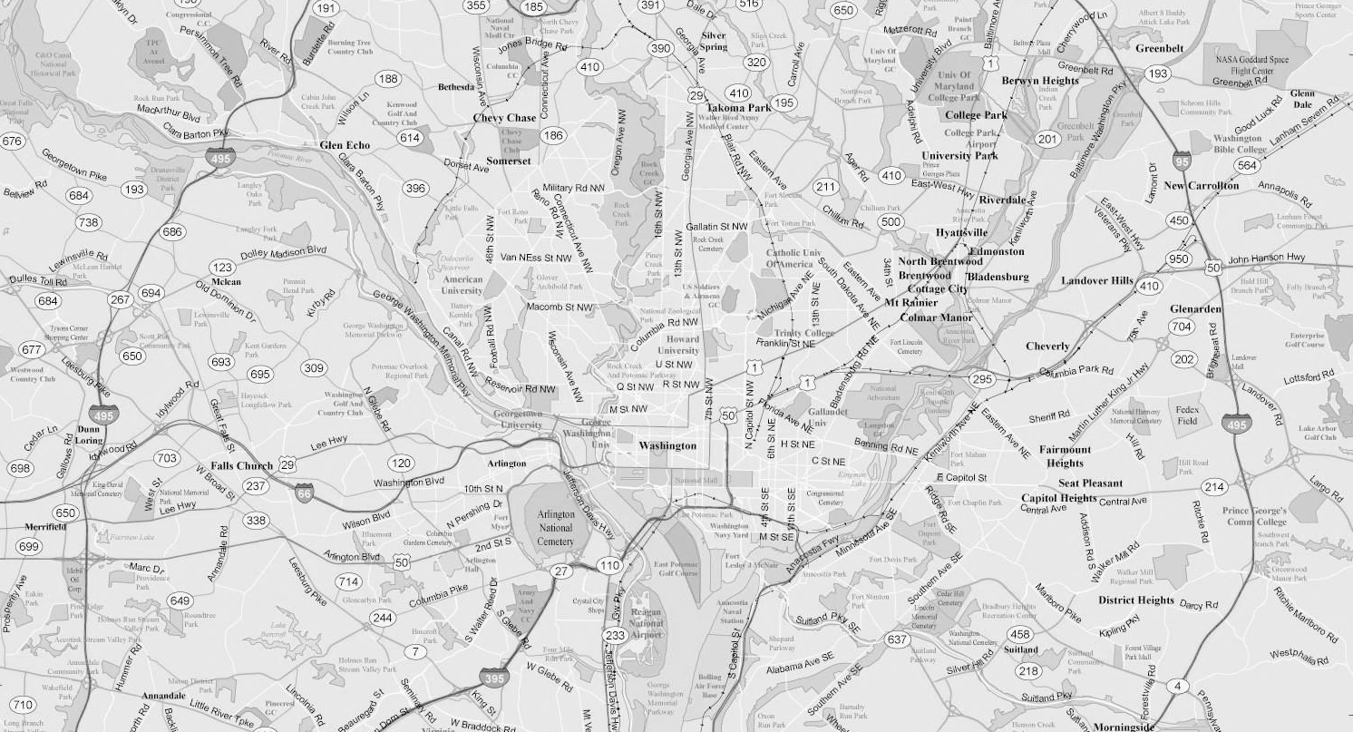
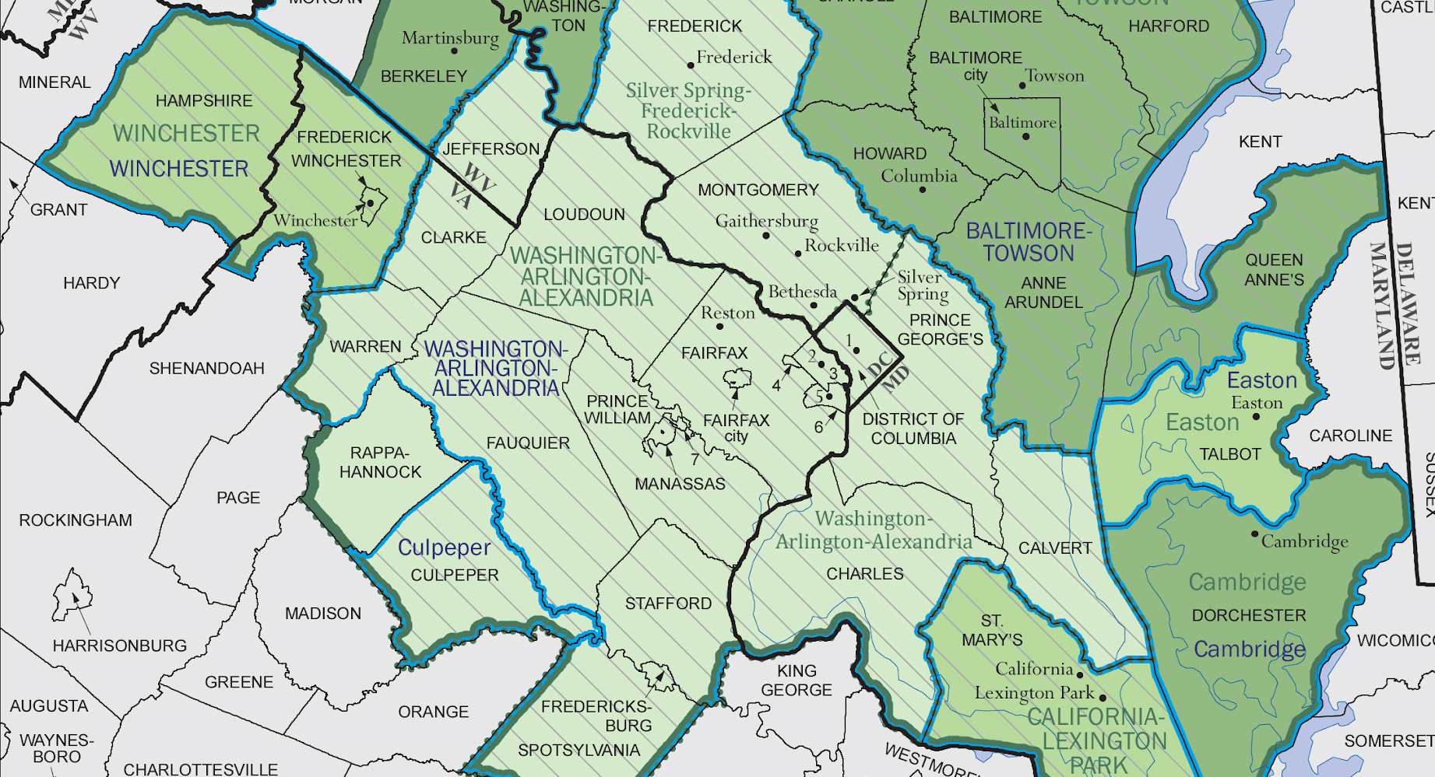

Analysis of 2000-2010 Air
Quality Trends in DMV Area
February 29, 2020
Dataset: New Pollution (Level 5)
Team: DC20052
Team Members: Nina Wang, Wanyun Yang, Bojing Fan
Mentor: Jennifer Chaffee

Slide 2
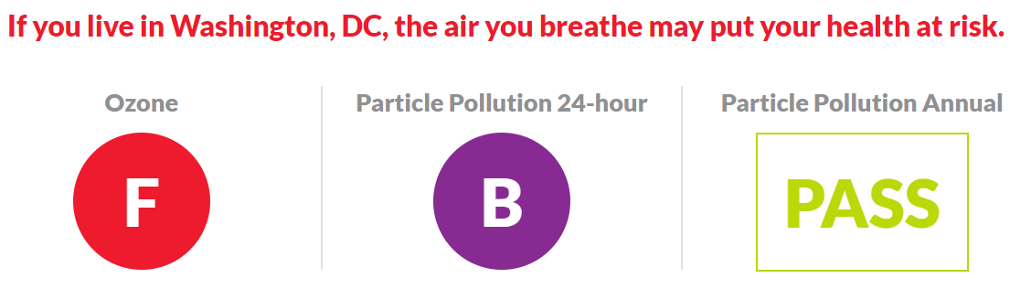
Source: Picture from American Lung Association (2020) https://www.lung.org/our-initiatives/healthy-air/sota/city-rankings/states/district-of-columbia/district-of-columbia.html

Slide 3
Dataset Overview

Slide 4
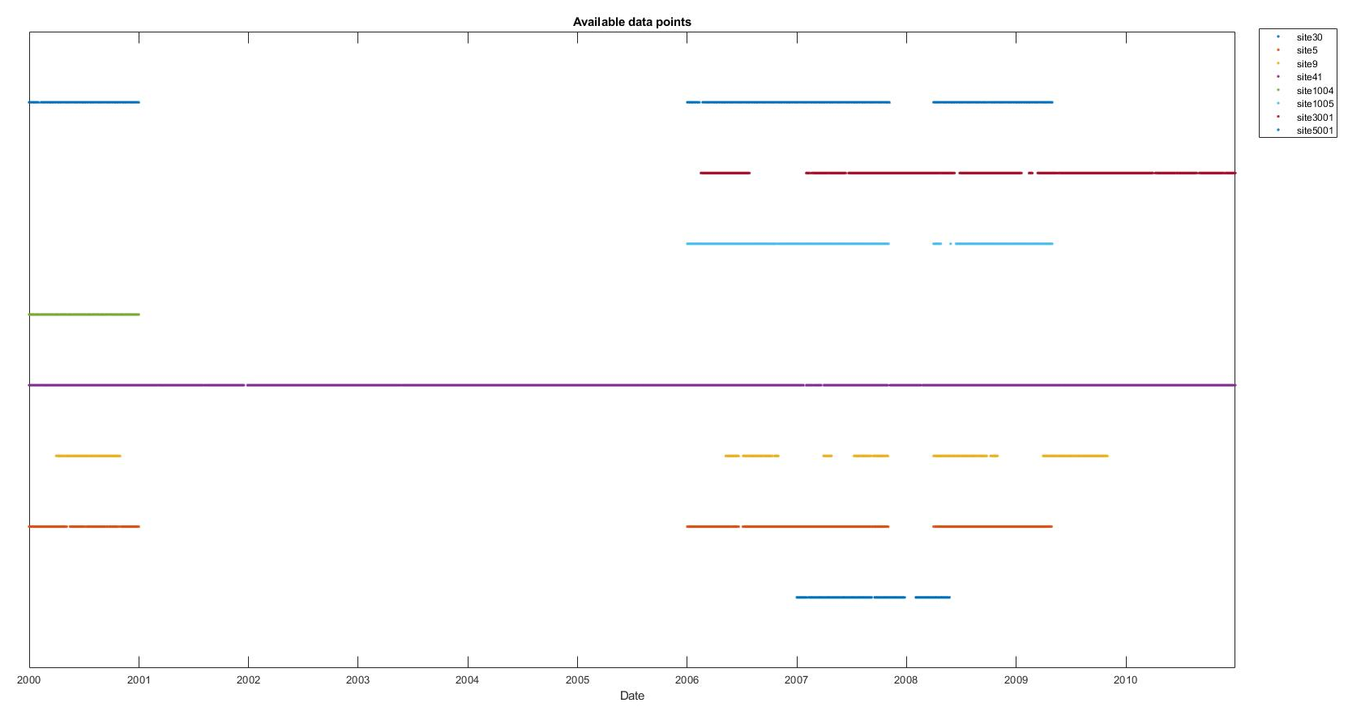
Dataset Overview
The provided dataset contained 43,894 rows, spanning from 1/1/2000 to 12/31/2010.
Notes:
SO2 1-hour 3-hour
NO2 1-hour
O3 8-hour

Slide 5
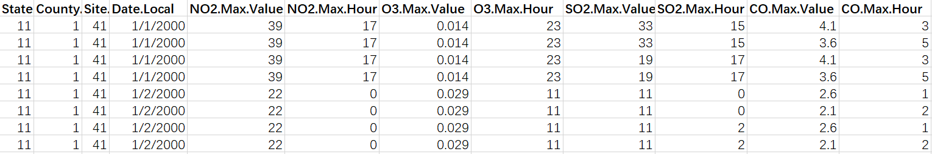
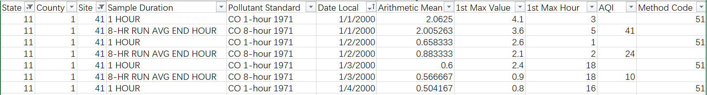
Dataset Overview
Notes:
SO2 1-hour 3-hour
NO2 1-hour
O3 8-hour

Slide 6
Dataset Overview: Data collection
The collected dataset contained 16,320 rows, spanning from 1/1/2000 to 12/31/2010.
Additionally, daily average wind speed and precipitation data were retrieved from NOAA.
Only records with observations of all four pollutants were included, which left us 10 sites in the area.
Notes:
Site 8 & 14 has a total of 134
National Oceanic and Atmospheric Administration

Slide 7
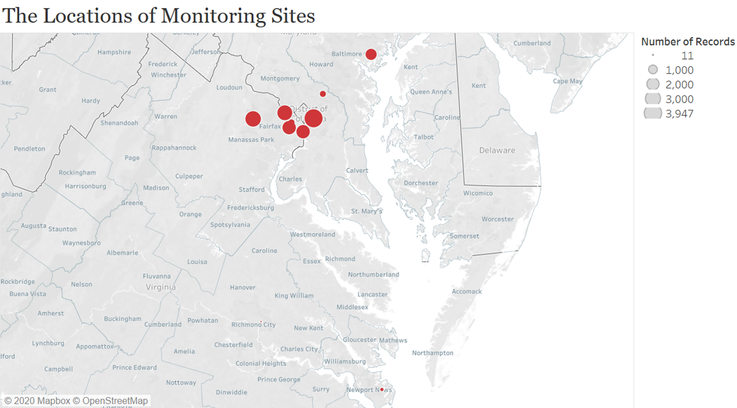
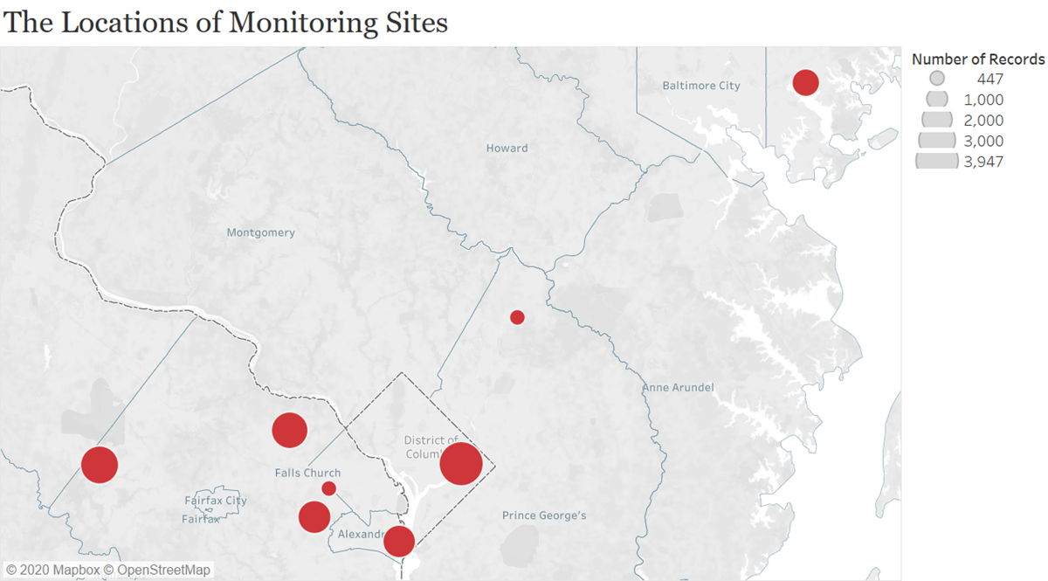
Dataset Overview: Collect raw data from EPA
Notes:
Site 8 & 14 has a total of 134
Majority is in DC metro
Baltimore only have data from 2005-2010

Slide 8
Time Series Analysis I

Slide 9
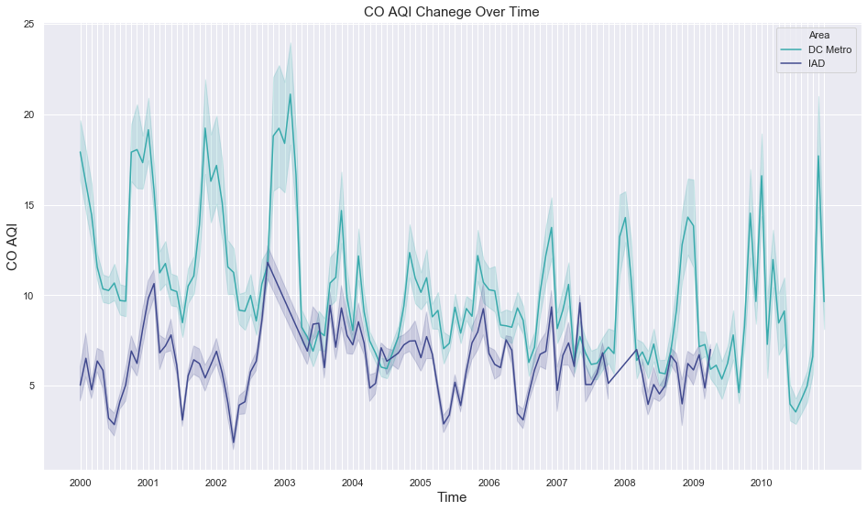


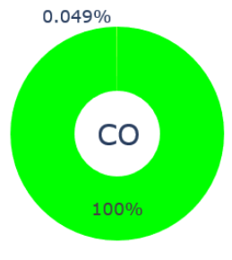
Carbon Monoxide
Drop
Urban
Suburban
Notes:
This plot shows the monthly changes of Carbon Monoxide from 2000 to 2010. You can see two lines here, the green line represents DC metro area, the other one shows IAD area. Due to the very limited amount of Baltimore data, we decided not to show it here. We can see a noticeable drop in 2003.
The pie chart uses different colors to show the proportion of days with different air pollution qualities. Overall, only 0.049% of days we have moderate amount of CO in the DMV area, the rest days are all good.

Slide 10
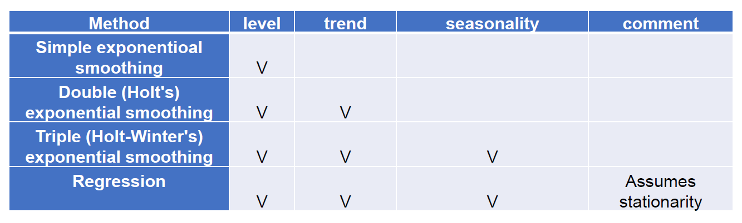
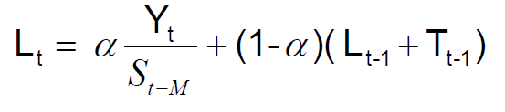
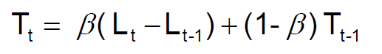
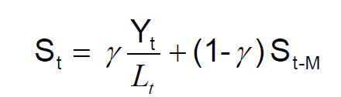
Since our data has obvious seasonality, we tried Winter’s Method:
𝐹𝑡+𝑛=𝐿𝑡+𝑛𝑇𝑡𝑆𝑡+𝑛
Notes:
Then we tried to do some time-series analysis here. From the previous line graph, we can see this data has level, trend, and seasonality. Therefore, we chose to use both Winter’s method and regression model. These formulas show how it works.

Slide 11
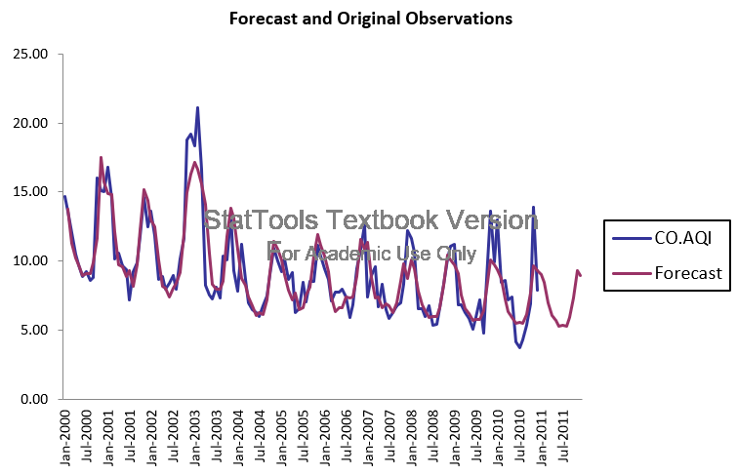
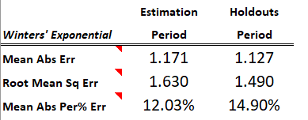
Notes:
For all these four types of pollutant, we divided the 11 years to 2 parts, 8 years for training and 3 years for validation. We also set the data of the next year as testing part. At the right upper corner, there is a table showing the error of our model over both training and validation periods.

Slide 12
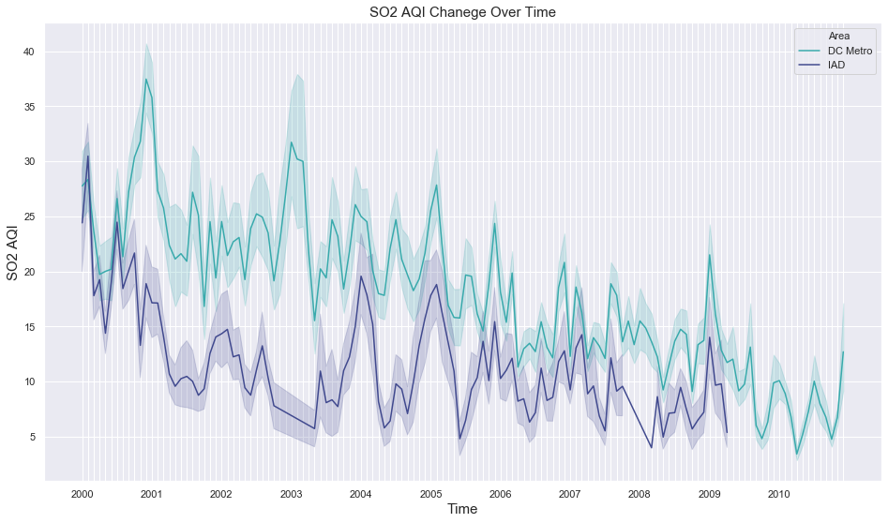
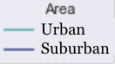
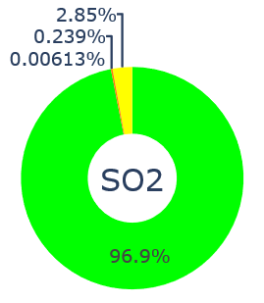
Sulfur Dioxide
Notes:
Then we did the same thing to Sulfur Dioxide.The amount of it keeps decreasing and we can see the overall situation is pretty good with 96.9% good condition days.

Slide 13
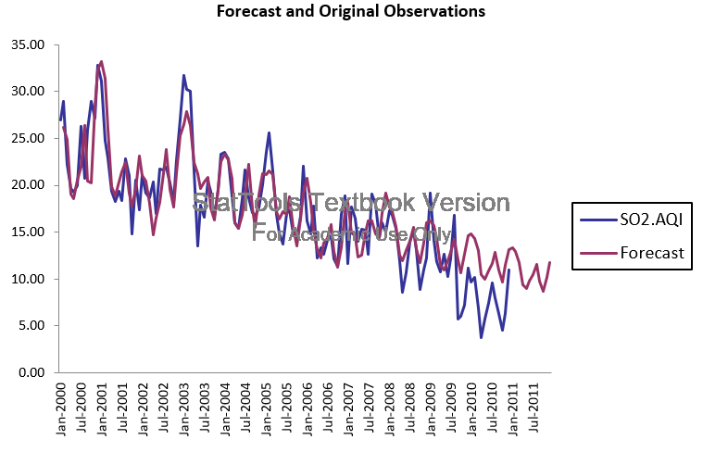
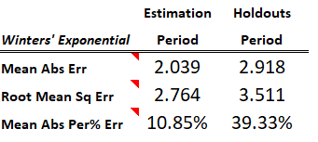
Relatively big
Notes:
This is the best result we can fit, but you can see this model does not fit as well as the one for CO.

Slide 14
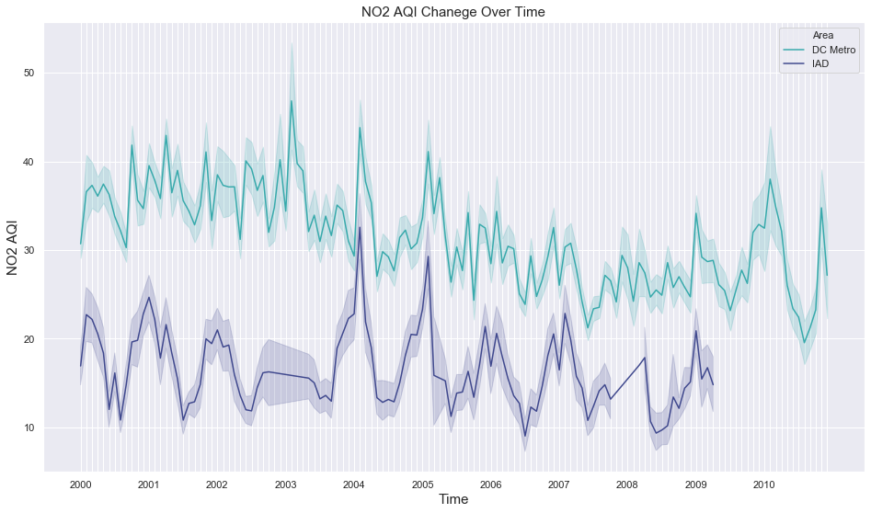
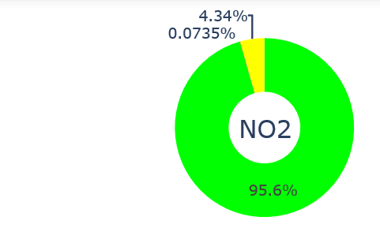
Nitrogen Dioxide
Notes:
For Nitrogen Dioxide, we can see a obvious gap between the two lines. This is reasonable because autos are a major source of NO2 emission and urban area tends to have more cars. 95.6% of the pie charts are green, so it is good.

Slide 15
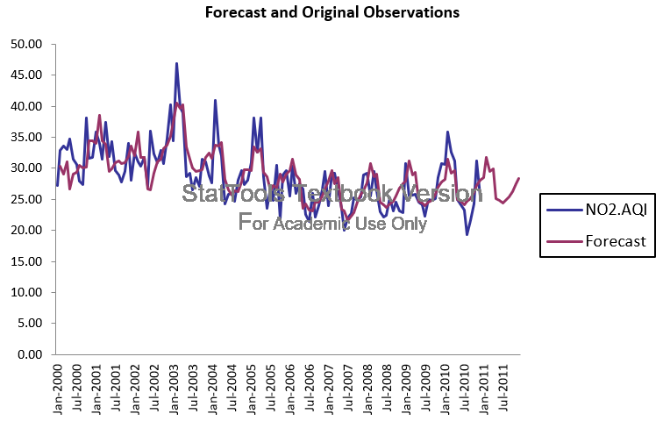
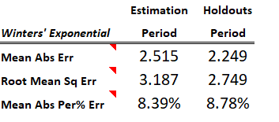
Small
Notes:
We can see the errors we have here are very small, which implies we have a good predictive model.

Slide 16
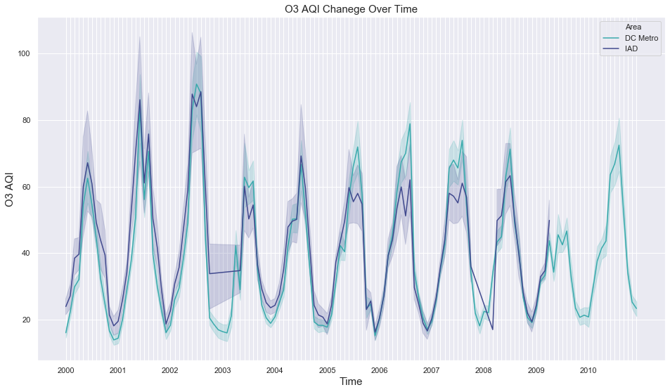
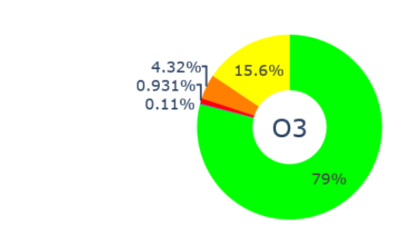
Ozone
EPA reclassified the Metropolitan Washington area as a severe nonattainment area.
=> More regulations over air pollution issue
Drop
Notes:
This one is for Ozone and the green line in the middle shows the cut off between good and moderate air pollution levels.
Ozone also had a drop in 2003.
Looking at the pie chart, we can tell O3 is the primary pollutant in the DMV area. 5.4% days are unhealthy for sensitive groups or worse.

Slide 17
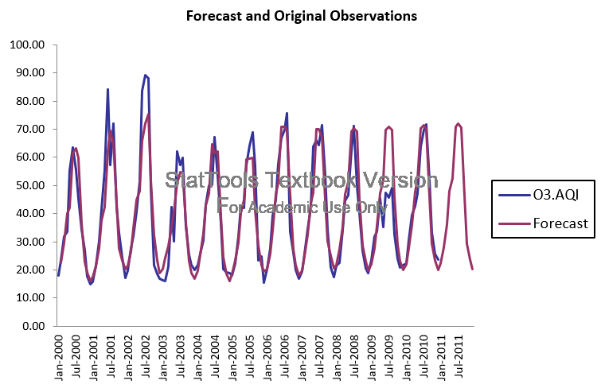
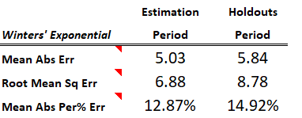
Notes:
This is the Winter model for Ozone. Winter is doing a better job on prediction than regression models, but it cannot help us analyze the factors and their effect on the pollution level. So, Bojing will talk more about it.

Slide 18
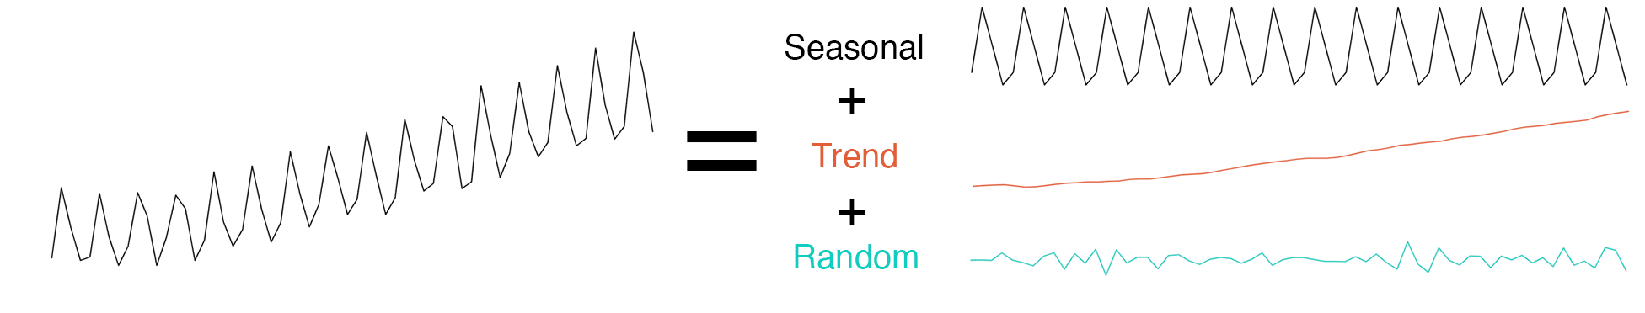
Time Series Analysis II

Slide 19
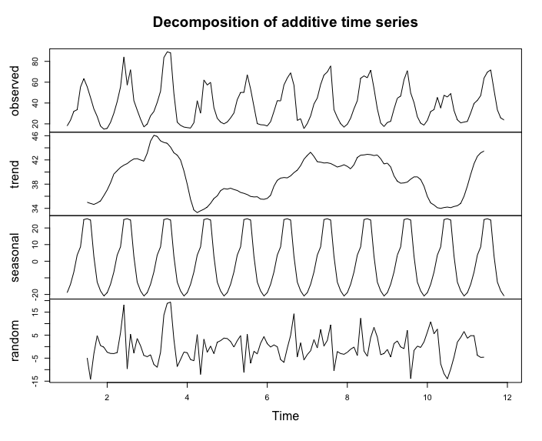

Slide 20
Model outcomes
Semi-log model of Ozone (Adj R²:0.3795)
Significant factors | Interpretation
State.Code | VA (3.45941) > MD (1.49926)> DC
Season | Summer > Spring > Autumn > Winter
Daytimes | Morning > Afternoon > Evening > Night
CO | Positive Correlation (0.26661)
NO2 | Positive Correlation (0.27092)
SO2 | Positive Correlation (0.06627)
Wind Speed | Negative Correlation (-0.09780)

Slide 21
Suggestion for Reducing Ozone Emission
NOx ❌ + Sunlight ❌ + VOC ✅
Ozone
Reduce VOC (Volatile Organic Compounds)
Notes:
On July 16, 2019, EPA approved the redesignation of the District of Columbia from marginal nonattainment to attainment for the 2008 NAAQS for ozone
Ozone is secondary pollutant

Slide 22
Implements
Avoid using aerosol consumer products such as hairsprays, air fresheners, deodorants, and insecticides that often use VOCs as their propellants.
Avoid using VOC-containing products such as organic cleaning solvents.
Store VOC-containing products in air-tight containers.
Buy products with less packaging as the printing of packaging materials generates VOCs.
Drive less, share rides and use public transportation.
Source: EPA(2011). Volatile Organic Compound (VOC) Control Regulations. https://www3.epa.gov/region1/airquality/voc.html
Notes:
According to a study from EPA, 51% of VOC is from mobile. So one way to reduce VOC is to encourage citizens to use more public transportation.
In our case, DC area has one of the most advanced metro system in the state. The government should keep working on it, the metro system so that more
And more people are not only willing, but enjoy taking public transportation. One thing should always be kept in mind that meeting the health-based air quality standards is one of the administration’s top priorities because all human beings have the right to breathe clean air

Slide 23
Thank you!

